Slide 1
Open Asian Food Restaurant in Toronto

Slide 2
Introduction:
Many people love Asian food or try to taste it, so if someone decide to open Asian food restaurant then he must put in his consideration the location where he could open it because the location is one of the most important business decisions. So this project provide a suggestion of the best locations for open a new restaurant that provide an Asian food in Toronto to everyone wants to open an Asian food restaurant in Toronto.

Slide 3
Research question:
Where is the best place to open a new Asian food restaurant in Toronto ?
research objective:
analyze and find the best location that is to be suitable for Asian food restaurant in Toronto

Slide 4
Data collection
1. Toronto neighborhoods via Wikipedia.
2. Latitude and longitude of neighborhoods using geocoder package.
3. venue data related to those neighborhoods using Foursquare API.

Slide 5
Methodology:
create dataframe that contain the Toronto data.
define Foursquare Credentials and Version and get the top 200 venues that are within a radius of 2000 meters and find out how many unique categories can be curated from all the returned venues in order to Analyze Each Area.
define Foursquare Credentials and Version and get the top 200 venues that are within a radius of 2000 meters and find out how many unique categories can be curated from all the returned venues in order to Analyze Each Area.
create the new dataframe and display the top 10 venues for each Postalcode and Calculate the total number of restaurants in each region and create dataframe that calculate the sum of all restaurants in the Neighborhoods the the number of the Asian restaurant in the same Neighborhoods , then combine the two datafarames in final dataframe that will be use in clustering.
cluster the area using 5 clusters and create map that visualize the resulting clusters

Slide 6
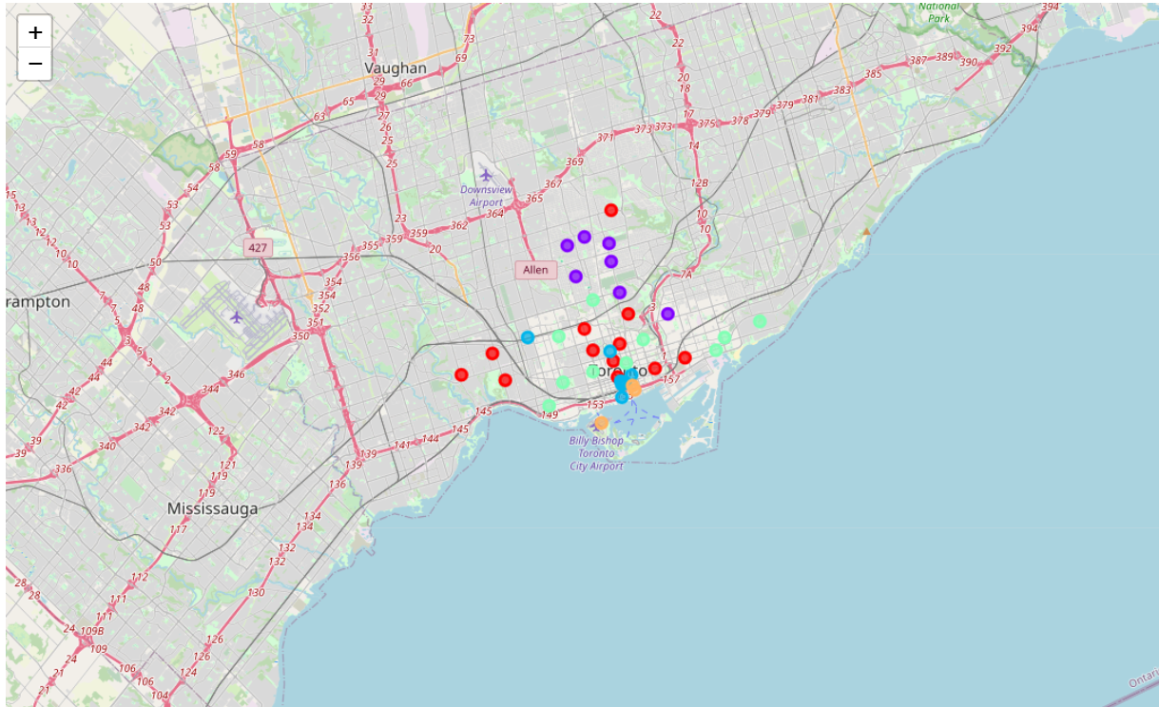
Result:

Slide 7
Discussion:
The above result of clustering determined that the neighborhoods corresponding to cluster 5(label 4) the best choice for opening Asian restaurant base on distribution of other restaurants,

Slide 8
Conclusion:
Invest in new business like open a restaurant is a sensitive decision and the determine its location is one of the most important thing in this business decisions, so it’s important to do some research to choice the location where can you open a restaurant in order to guarantee the success of the business .

Slide 9
References:
https://en.wikipedia.org/wiki/List_of_postal_codes_of_Canada:_M

